Slide 1

Technology-enabled Communication
CHAPTER EIGHTEEN

Slide 2
Overview
Tools for constructing messages in all stages of the writing process
Tools for presenting messages
Basic document layout and design
Tools for transmitting messages
Tools to assist collaboration
Future developments

Slide 3
Tools for Constructing Messages
Writing Activity
Empowering Tools
Planning
Gathering and Collecting Information
Analyzing and Organizing
Writing
Outlining or Brainstorming
Project Management
Personal Information Managers
Push
Database
Statistics
Spreadsheet
Graphics
Outlining or Brainstorming
Word Processing/Voice Recognition
Spelling Checker/Thesaurus
Grammar and Style Checker
Reference
Graphics and Drawing
Information Rights Management (IRM)

Slide 4
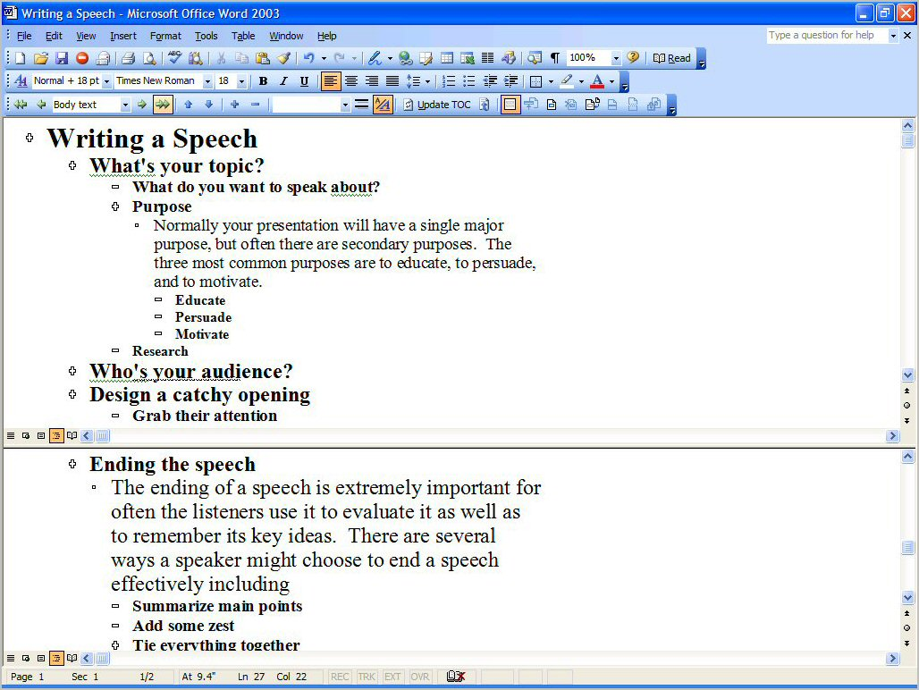

Slide 5
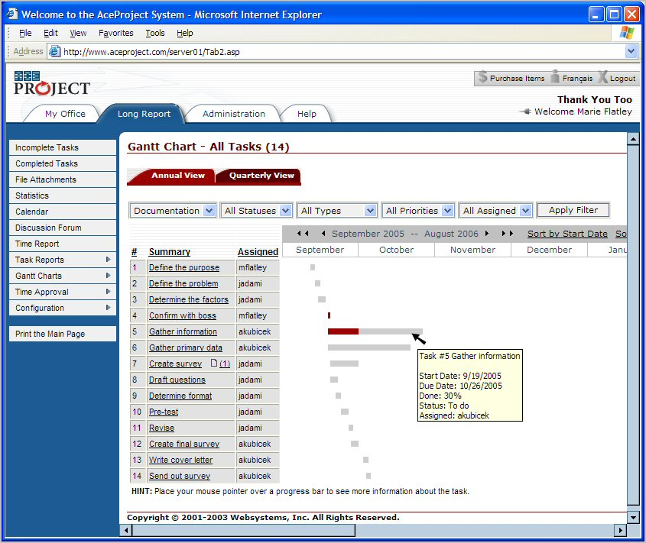

Slide 6
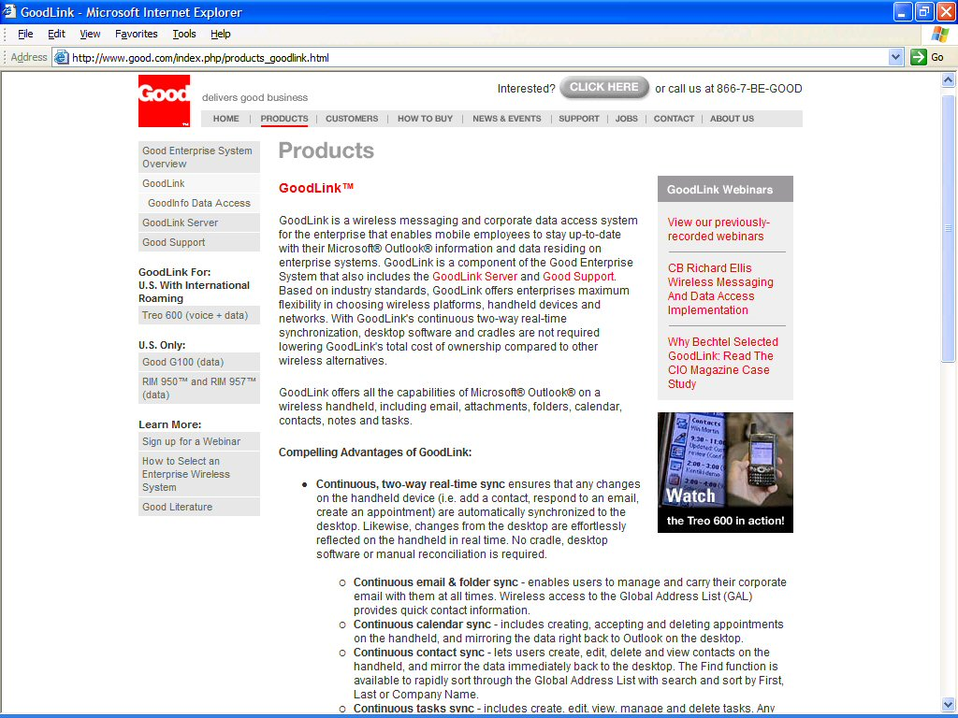

Slide 7
Tools for Constructing Messages
Writing Activity
Empowering Tools
Planning
Gathering and Collecting Information
Analyzing and Organizing
Writing
Outlining or Brainstorming
Project Management
Personal Information Managers
Push
Database
Statistics
Spreadsheet
Graphics
Outlining or Brainstorming
Word Processing/Voice Recognition
Spelling Checker/Thesaurus
Grammar and Style Checker
Reference
Graphics and Drawing
Information Rights Management (IRM)

Slide 8
Push Technologies
Filtered Channels
  my.yahoo.com, my.excite.com
  Company portals
Personal Agents
  Google news alerts
  Journal alerts

Slide 9
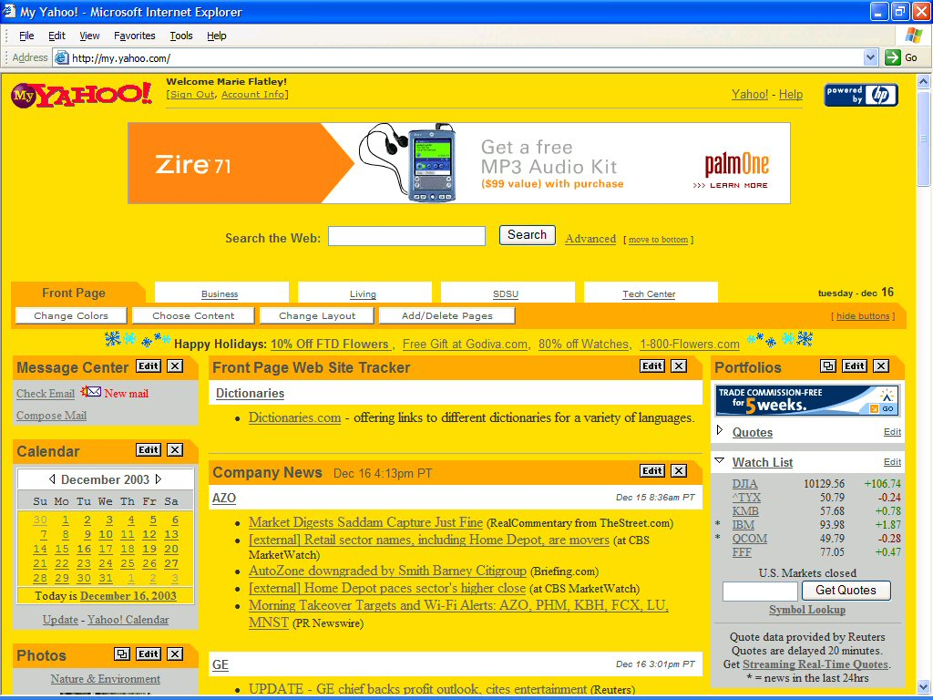

Slide 10
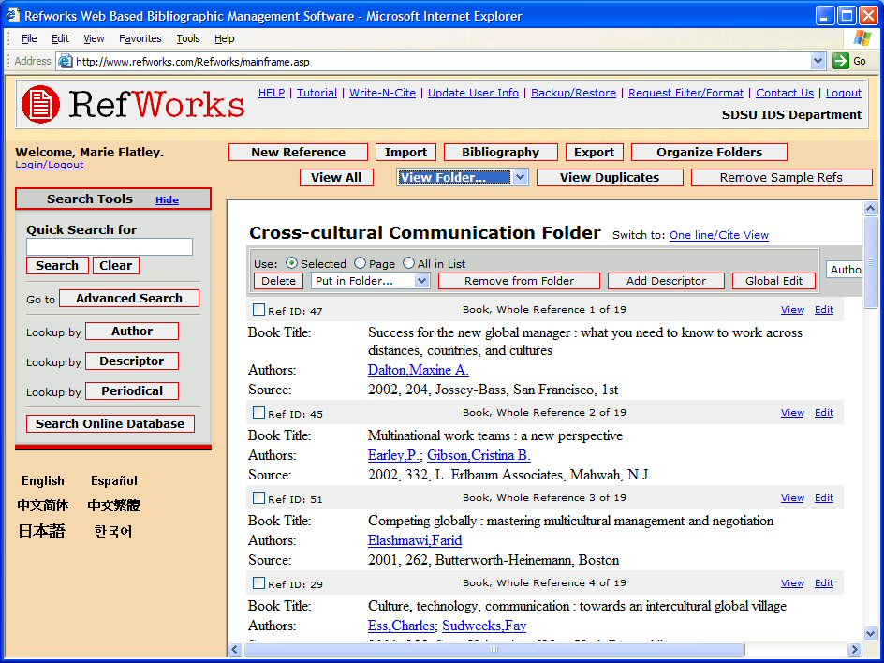

Slide 11
Tools for Constructing Messages
Writing Activity
Empowering Tools
Planning
Gathering and Collecting Information
Analyzing and Organizing
Writing
Outlining or Brainstorming
Project Management
Personal Information Managers
Communications/Push
Database
Statistics
Spreadsheet
Graphics
Outlining or Brainstorming
Word Processing/Voice Recognition
Spelling Checker/Thesaurus
Grammar and Style Checker
Reference
Graphics and Drawing
Information Rights Management (IRM)

Slide 12
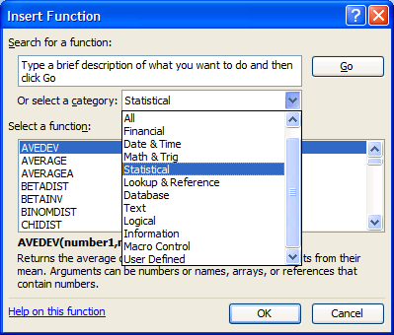
Excel Statistics

Slide 13
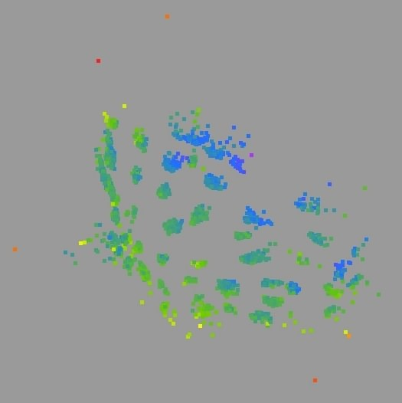
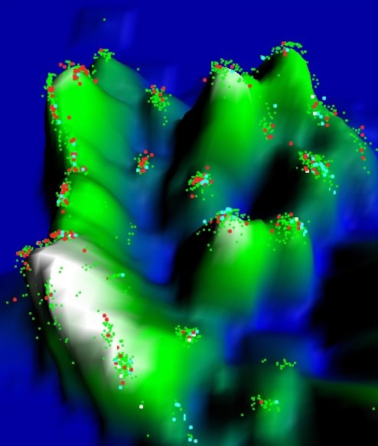
Graphics from Data Mining
Courtesy of Omniviz

Slide 14
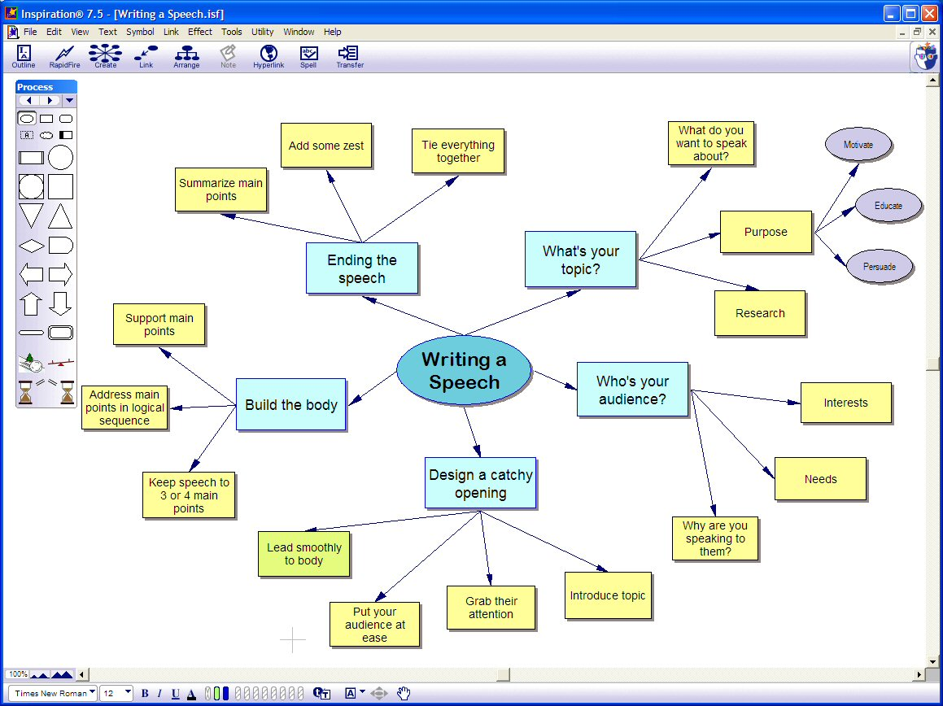

Slide 15
Tools for Constructing Messages
Writing Activity
Empowering Tools
Planning
Gathering and Collecting Information
Analyzing and Organizing
Writing
Outlining or Brainstorming
Project Management
Personal Information Managers
Communications/Push
Database
Statistics
Spreadsheet
Graphics
Outlining or Brainstorming
Word Processing/Voice Recognition
Spelling Checker/Thesaurus
Grammar and Style Checker
Reference
Graphics and Drawing
Information Rights Management (IRM)

Slide 16
Some Word Processing Features for Business Writers
Editing/Revising Features
Special Function Features

Slide 17
Editing/Revising Features
Insert/Delete
Move/Copy
Search/Replace
Calculating/Sorting
Tables
Hidden Text or Remarks
Hyphenation
Formatting/Styles

Slide 18
Special Function Features
Footnotes
Table of Contents and Index Generators
Merge
Macros
QuickText and AutoText Shortcuts
Headers and Footers

Slide 19

Voice Recognition
Just talk to your PC and your words appear immediately on the screen, in letters, email, chat rooms, and more.
See video demo on the text web site.

Slide 20
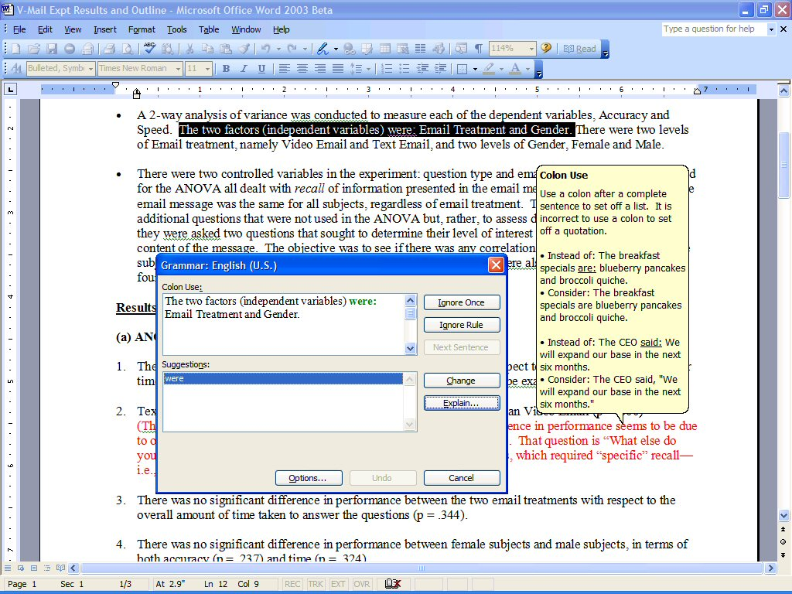

Slide 21
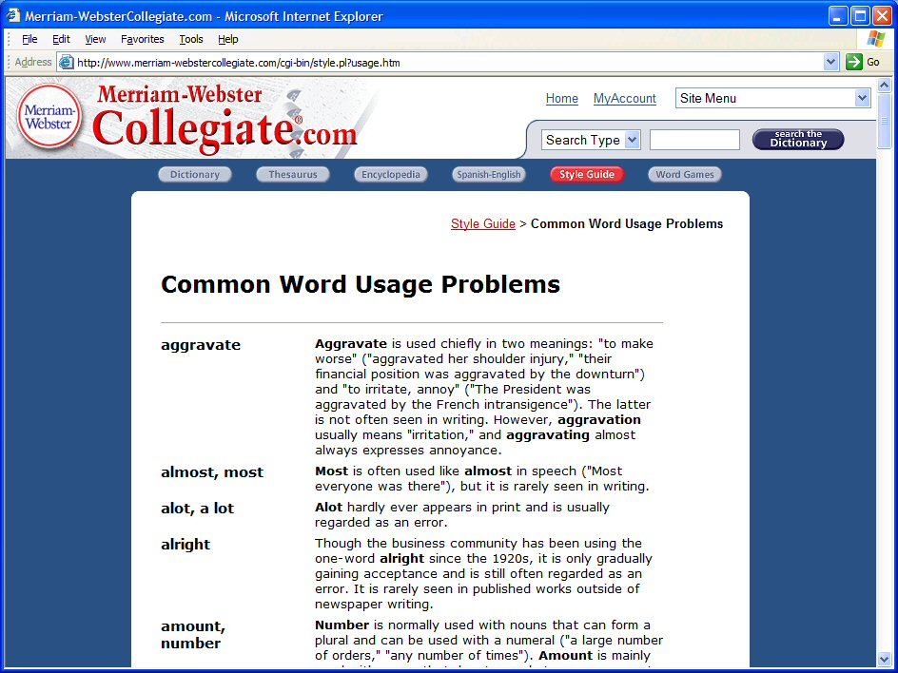

Slide 22
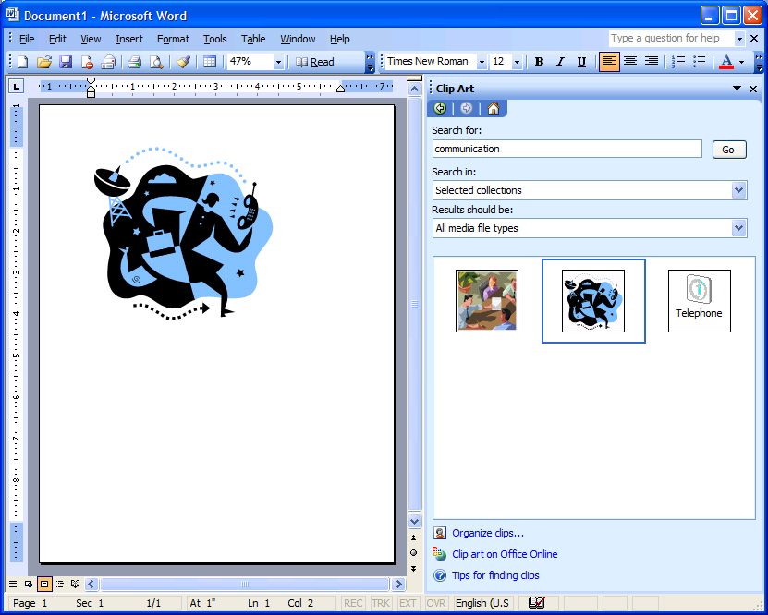

Slide 23
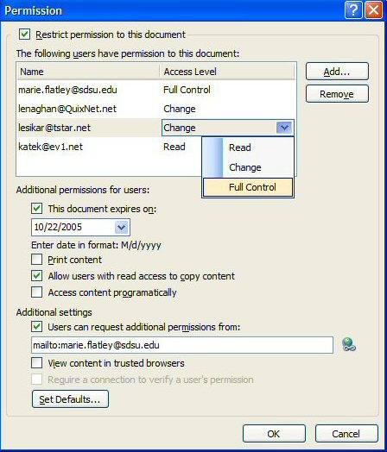
Information Rights Management (IRM)

Slide 24
Tools for Presenting Messages
Software
  Desktop Publishing
  Word Processors
  Web Authoring Tools
  Portable Document Publishers
Hardware
  Printers
  Computer Displays

Slide 25
Publishing Components
Basic Layout Principles
  White Space
  Text
  Visuals
Typography
  Points and Picas
  Kerning
  Leading
  Font/Typeface
Art Fundamentals

Slide 26
Formats for Presenting Messages
Print
Electronic
  Web Documents: User has primary control of appearance; however, new HTML standards such as style sheets are giving some control back to the writer.
  Portable Documents: Writer has control of the appearance of these documents that run on multiple platforms.

Slide 27
Tools for Transmitting Messages
Channel Characteristic
Physical Tool
Oral Messages
Visual Messages
Combinations
Mobile Phones
Voice Message Systems
Sound Files/Internet Phones
Paper
Electronic Mail/Pagers
Facsimile (Fax)
Hypertext Documents
Videoconferencing
Smart Phones/Video Email
Compound Documents

Slide 28
Tools for Collaboration
Form
Tools
Asynchronous
Synchronous
Word Processing
Conferencing Systems
Electronic Mail/Listservs
Groupware
Face-to-face Meeting Systems
Distributed Meeting Systems

Slide 29
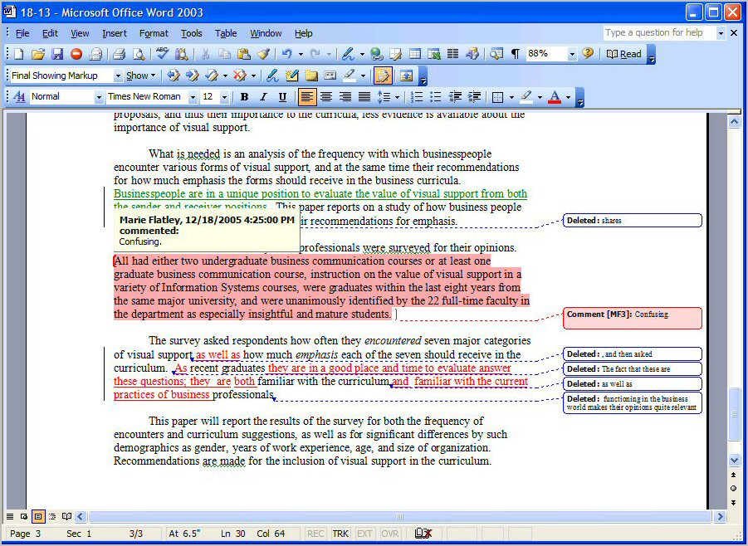

Slide 30
Examples of Synchronous
Collaboration Tools
Face-to-Face Tools
  Group Systems
  Polycom
  VTEL
Distributed and Web-based Tools
  WebEx
  Groove
  Microsoft Office Live Meeting (Placeware)
  Centra

Slide 31
Future Technologies
Near Term
Improved voice recognition
Enhanced graphics
Document retrieval
Document management
Wireless communication

Slide 32
Future Technologies
Longer term
Adaptive computing
Machine learning
Real-time face detection recognition

Slide 33
Future Technologies
Result:
Human mind will continue to control message formulation.
Increased need for more people with good communication skills.
Advances in technology are more likely to increase the demand for people with good writing and speaking skills.

Slide 34
“Machines should work. People should think.”
--a motto attributed to IBM

